Slide 1
ITCZ convection inhibition with the Atmospheric Brown Cloud
A major cause of climate change which can and must be stopped

Slide 2
The Asian Brown Cloud (ABC) is typically produced by pollution from:
Clearing and burning of rainforests
Burning off stubble from rice and wheat crops
Burning cow dung as fuel for cooking
Emissions from industrial smokestacks
The ABC strongly inhibits convection within the troposphere:
“What we see in the observations is that when air picks up water vapour from the ocean surface and rises up, it often only rises a few kilometres before it begins its descent back to the surface," Sherwood said. "Otherwise it might go up 10 or 15 kilometres.”
“And those shorter trajectories turn out to be crucial to giving us a higher climate sensitivity because of what they do to pull water vapour away from the surface and cause clouds to dissipate as the climate warms up.”
https://www.voanews.com/a/study-warmer-world-will-produce-fewer-clouds/1822952.html

Slide 3
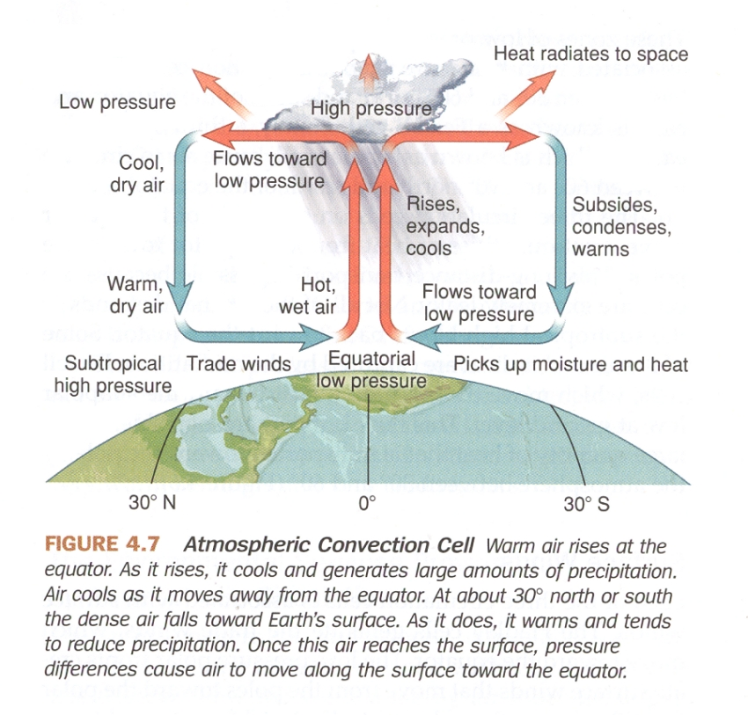
Normal convection within the Intertropical Convergence Zone (ITCZ)
The Hadley Cell
Around 55% of Earth’s radiation of heat to Space normally takes place in the Hadley Cell

Slide 4
Global distribution of rainfall
High rainfall is naturally correlated to the ITCZ and zones of high heat convection to Space

Slide 5
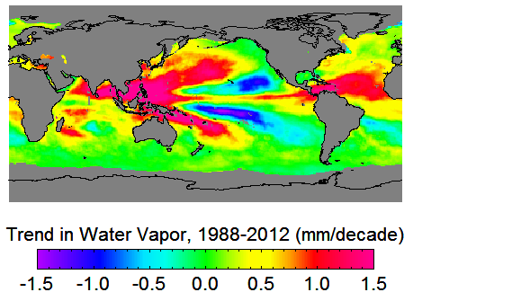
Increase in Atmospheric Water Vapour Levels 1988-2012
http://www.remss.com/research/climate
mm/decade
However, the measured build-up of water vapour across large swathes of Asia and Central America reflects a failure of the global monsoon convection system

Slide 6
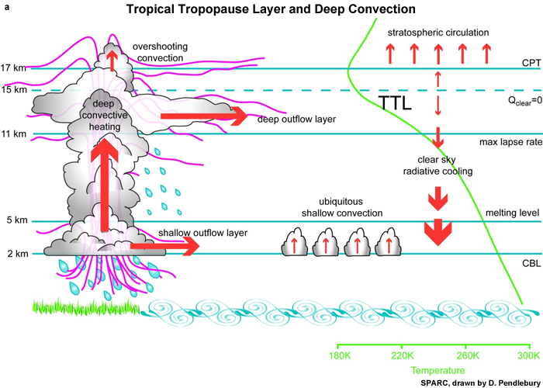
Ordinary convection inhibited by atmospheric pollution (atmospheric brown cloud)

Slide 7
Enhanced Convection With Vortex Engine
Enhanced convection with vortex engine overcomes inhibition

Slide 8
The biggest advantage of the vortex engine with geothermal power source is that it can be a baseload power system, able to supply 24/7.
Other advantages include the fact that it will enhance tropospheric convection, hence being a significant factor in the reversal of global warming.
Conventional wind farms arguably actually act to inhibit convection.

Slide 9
Thank you

