Slide 1
A proposal for research and development in the area of high energy sonoluminescence
hypersonic focused shockwaves

Slide 2
Intense focused shock waves arguably have application in:
  research into ultra high temperature plasma physics
  production of nanophase materials
  “sonochemistry”
The common factor in each case is ultra high temperatures

Slide 3
The downside of the imploding bubbles - Cavitation

Slide 4
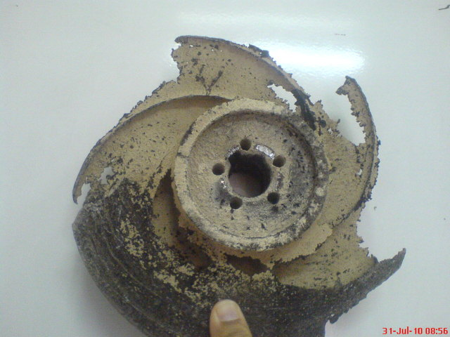
Cavitation

Slide 5
Making a virtue of necessity –
Sonoluminescence
Sonoluminescence means “light from sound.”
Sonoluminescence is normally studied within a small (~4 micron ambient radius) air bubble in a liquid such as water which has been exposed to variations in pressure, typically from high frequency sound waves (typically ~30 kHz).

Slide 6
Sonoluminescence - Mechanism
The supersonic collapse of the bubble launches an imploding spherical shock wave, the strength and velocity of which varies inversely as the square of the radius.
Thus if it were possible to focus the shock wave to a point (or a line), at zero radius its velocity and intensity would theoretically be infinite.
Limits on the minimum volume of the focus are imposed because imploding shock waves usually tend to become unstable as initial irregularities in sphericity become more significant at smaller scales.

Slide 7
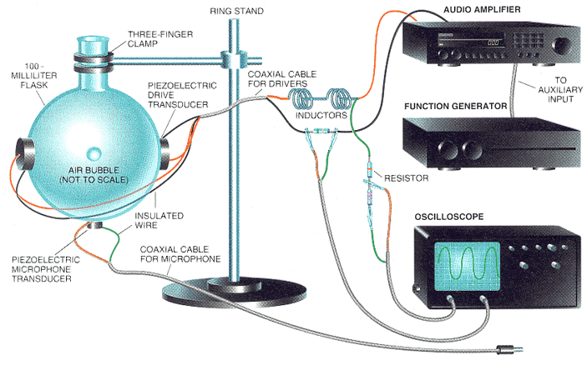
Sonoluminescence

Slide 8
Sonoluminescence
Scientific American February 1995

Slide 9
Sonoluminescence - Bubbles “hotter than the Sun”

Slide 10
Sonoluminescence - Bubbles “hotter than the Sun”
“…Prospects for initiation of thermonuclear fusion reactions within a sonoluminescing bubble were suggested when theoretical simulations of the SBSL phenomenon by Wu and Roberts showed the existence of maximum bubble temperatures of the order of 10^⁸ K!”
“These extreme temperatures were limited to a small region of the bubble interior and were made possible by the launch of a shock wave within the already compressed gas. The shock focuses as it approaches the bubble centre and doubles its strength when reflected from the origin.”
“In an another study, Moss et al. showed that hydrodynamic simulations of a collapsing bubble containing D₂ and D₂O vapour provide the possibility for a small number of thermonuclear D–D fusion reactions in the bubble...”
Sonoluminescence and bubble fusion
Vijay H. Arakeri
Department of Mechanical Engineering, Indian Institute of Science, Bangalore, India

Slide 11
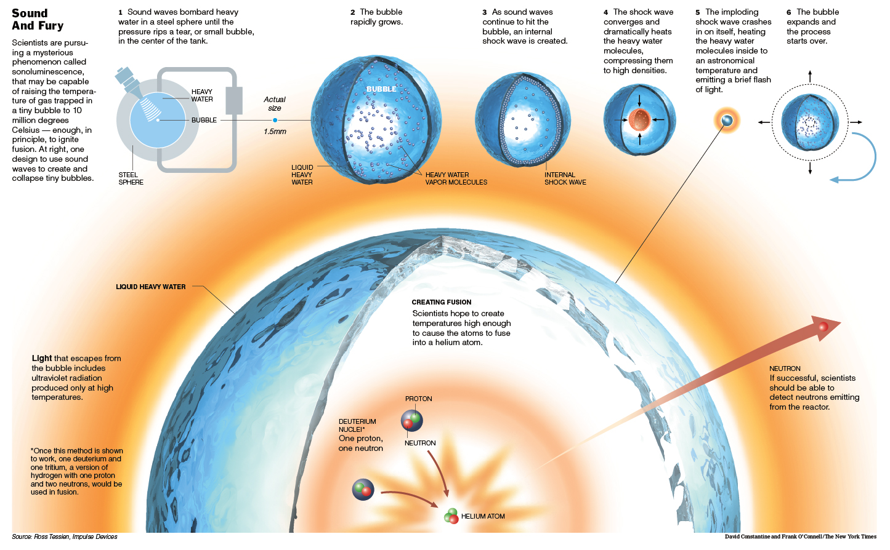
Implosion

Slide 12
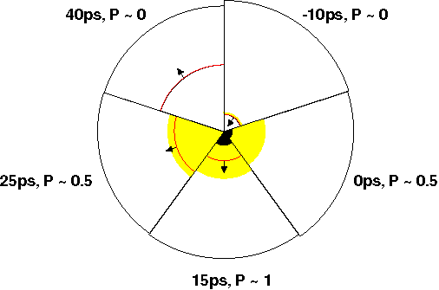
Sonoluminescence implosion – output from a computer model
Shock wave
5
1
Bubble surface
LASNEX output
Light emitting region (yellow)
Optically opaque (black)
4
2
3
“The final 50 ps of the calculated collapse of an argon bubble. The bubble radius (outermost curve), shock wave location (inner curve), and emitting regions [optically thin (yellow), and optically [opaque] (black)] are shown. P is the relative emitted power (energy per unit time) of light in the visible part of the spectrum.” http://acoustics.org/pressroom/httpdocs/133rd/2apa10.html

Slide 13
Bubbles within a gravitational field are not perfectly spherical. Sonoluminescence ideally should operate in microgravity
arXiv:1303.4872 [physics.flu-dyn]

Slide 14
Larger scale bubble
Sonoluminescence rig
PHYSICAL REVIEW E 69, 066317 (2004)
Cavendish Laboratory, Cambridge
Excitation frequency = 20 - 200 Hz
Spin rate N ~ 20 rev./sec
Bubbles of 0.4 mm ambient radius (containing 23x10^¹⁴ xenon atoms) were excited by vibration at 35 Hz. Approximately 10^¹² photons were emitted per collapse in the range 400–700 nm (over four orders of magnitude greater than the brightest SL reported previously), corresponding to a 1% efficiency of the conversion of mechanical energy into light.
Note bubble size two orders of magnitude larger diameter than for a conventional sonoluminescence rig.

Slide 15
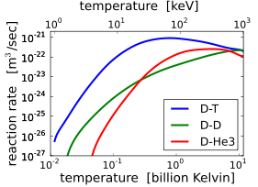
2.6 keV
12.9 keV
30 MK
150 MK
https://commons.wikimedia.org/wiki/File:Fusion_rxnrate.svg

Slide 16
Fusion parameter continuum
Magnetic Confinement Fusion
Inertial Confinement Fusion
Magnetized Target Fusion
National Ignition Facility
Tokamak
Linus
General Fusion
N = 1E14 | N = 1E17 | N = 1E20 |  | N = 1E25
P = 1 Bar | P = 1 kBar | P = 1 MBar |  | P = 100 GBar
v = 0 km/s | v = 0.5 km/s | v = 5 km/sec |  | v = 370 km/s
τ = 1 s | τ = 1 ms | τ = 7 μs |  | τ = 10 ps
The Lawson criterion depends on having the right combination of N, T and τ.
Dr. Michel Laberge - Fusion Neutrons from a Strong Spherical Shock Wave Focused on a Deuterium Bubble in Water.pdf

Slide 17
Magnetized Target Fusion or
Inertial Confinement Fusion
General Fusion

Slide 18
General Fusion MTF
General Fusion is building upon previous work and research information developed at the different National labs, and attempting to create a relatively small-scale, low-cost fusion reactor using deuterium-tritium gas, magnetic confinement, and acoustic compression.

Slide 19
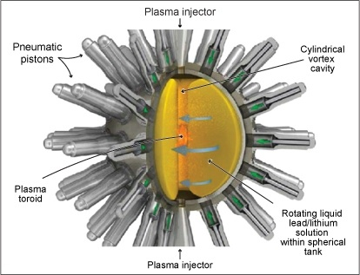
General Fusion MTF
Rotational axis

Slide 20
General Fusion MTF
General Fusion’s reactor is a metal sphere with 220 pneumatic pistons designed to ram its surface simultaneously. The ramming creates an acoustic wave that travels through a lead-lithium liquid and eventually accelerates toward the centre [as] a shock wave.
The shock wave compresses a plasma target, called a spheromak, to trigger a fusion burst. The thermal energy is extracted with a heat exchanger and used to create steam for electricity generation.

Slide 21
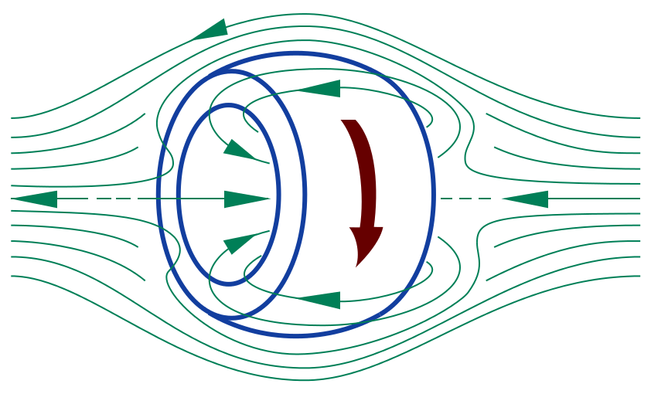
Field Reversed Configuration (Spheromak)
Field-reversed configuration (FRC): a toroidal electric current is induced inside a cylindrical plasma, creating a poloidal magnetic field, reversed in respect to the direction of an externally applied magnetic field. The resultant high-beta axisymmetric compact toroid is self-confined.

Slide 22
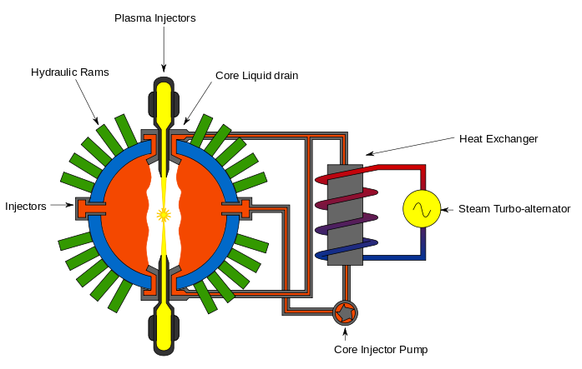
Diagram of the General Fusion Reactor
Evan Mason

Slide 23
Inertial Confinement Fusion
First Light Fusion

Slide 24
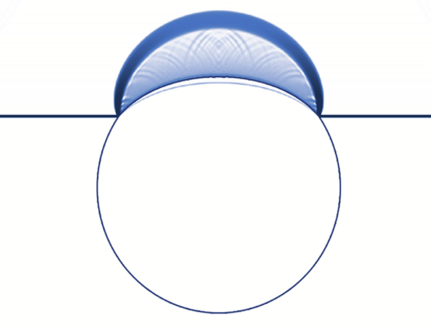
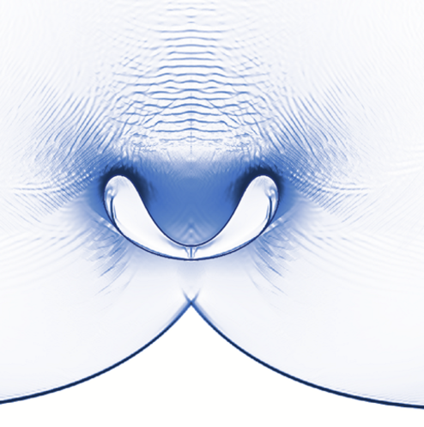
First Light Fusion
First Light Fusion is a spin-off from Oxford University department of mechanical engineering and claims to be able to harness instabilities by using asymmetrical implosion.
http://firstlightfusion.com/
See
Shock wave
Bubble
Bubble
Shock wave

Slide 25
First Light Fusion
First Light Fusion’s Scientific Advisory Board members include:
Chairman Arun Mujumdar - Professor of mechanical engineering at Stanford University and was the founding director of the US Advanced Research Projects Agency – Energy (“ARPA-E”).
Members Steven Chu - the former US Energy Secretary and 1997 Physics Nobel Prize laureate
Richard Dennis - former Director of Research and Development for Doosan Babcock Energy where he was responsible for power station boiler development and investments in new energy technologies
Richard Garwin - current IBM Fellow Emeritus at the Thomas J. Watson Research Centre in New York. At the age of 23, he was responsible for the design of the first H-bomb (1953).
Steven Rose - the former Head of Plasma Physics at Atomic Weapons Establishment Aldermaston and former Head of the Imperial College Plasma Physics Group.

Slide 26
Inertial Confinement Fusion
National Ignition Facility

Slide 27
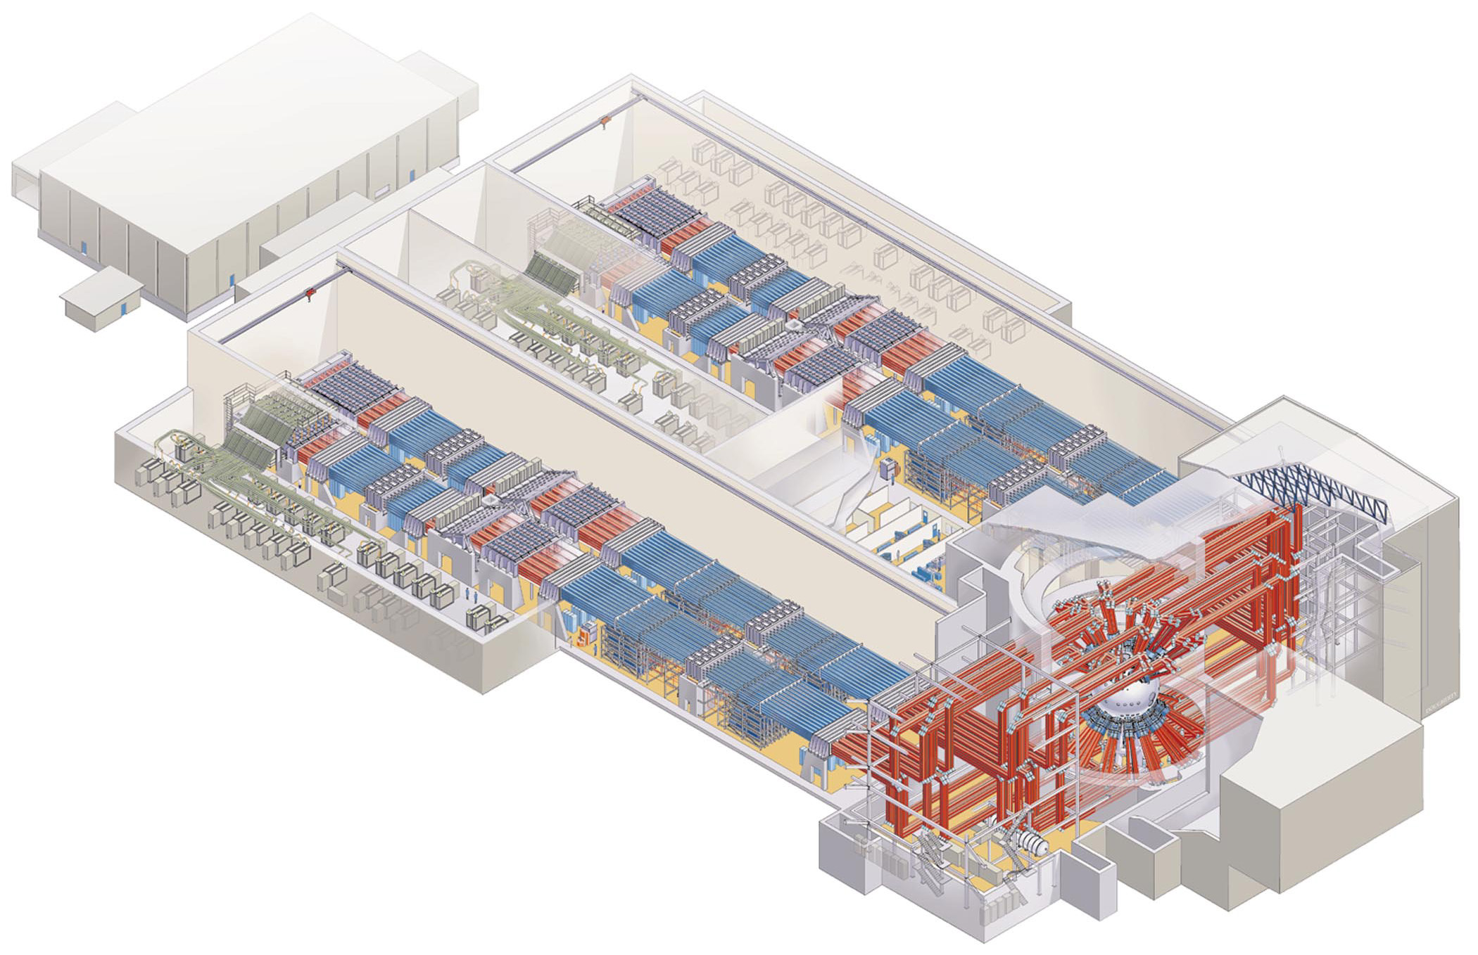
Inertial Confinement Fusion (laser)
Advantages:
Well advanced technology
Good control of energy release
Disadvantages:
Bad energy conversion (~1%)
Very expensive to build
Laser banks
Target
National Ignition Facility uses 192 intense lasers fired onto a small (approximately 1 cm) spherical shell containing a deuterium-tritium ice mixture, exploding the outside of the shell. The rest of the shell accelerates inwards, compressing and heating the fuel for a nanosecond burst of fusion.

Slide 28
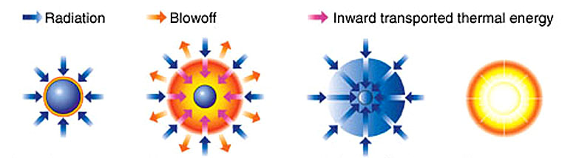
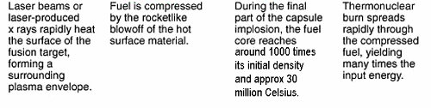
Inertial Confinement Fusion

Slide 29
Inertial Confinement Fusion
The Liquid Pendulum Engine

Slide 30
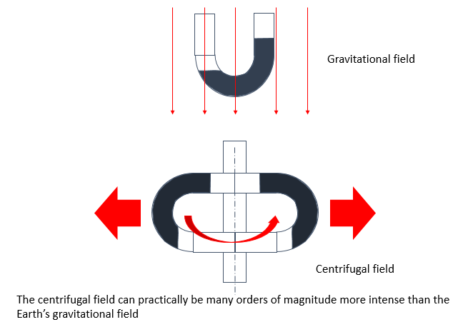
The Liquid Pendulum
f = 1/2𝜋 ∗ √((2 ∗ 𝑔)/𝐿)
where
g = acceleration due to gravity
L = length of the fluid column within the pendulum

Slide 31
The Liquid Pendulum Engine
Rotating housing
Eccentric rotating at the natural frequency of the pendulum
Bearing
Shock chamber
Liquid pendulum
Diagrammatic representation of one version of the Liquid Pendulum Engine

Slide 32
Rankine combined vortex
V_{φ}
Forced vortex
Free vortex
α R
α 1/R
a
R
In normal experience, vortices tend to be found as combined vortices.

Slide 33
Combined vortex within the Liquid Pendulum engine
V_{φ}
Shock wave front
α 1/R
α R
r
R
In the liquid pendulum engine, there is a discontinuity at the shock wave

Slide 34
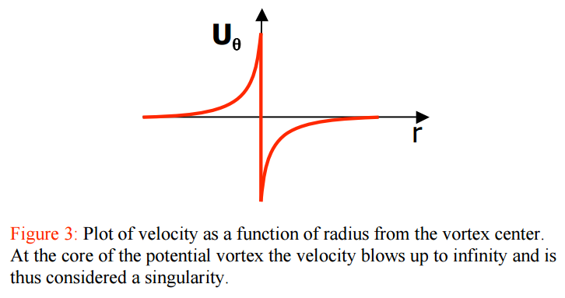
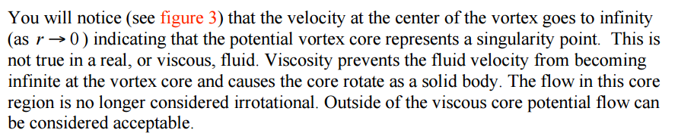
Singularity
http://web.mit.edu/2.016/www/handouts/2005Reading4.pdf

Slide 35
The Liquid Pendulum Engine
Because the liquid pendulum engine has the shock wave between the inner and outer regions of the vortex, no viscous drag can be transmitted to the inner core. Hence a free vortex can be maintained through to the focal point (or line).
Before final shock convergence, the flow has both radial and tangential components

Slide 36
The Liquid Pendulum Engine
At final convergence, all flow effectively has a radial component only
“Collinear” motion

Slide 37
Fusion efficiency vs. temperature
Random motion = low fusion efficiency
“Collinear” motion = high fusion efficiency

Slide 38
Possible Advantages of the Liquid Pendulum
The natural frequency of the system is far higher than that for other concepts.
The implosion process should be far more stable and efficient than that for any conceivable non-rotating system.
It is a relatively low cost system.
The coolant/liquid piston can protect the metal structure from neutron damage.
IF all the problems are resolved in terms of achieving fusion, it would be a “game changer” in terms of world energy supply.

Slide 39
Disadvantages of the Liquid Pendulum
Spinning the casing obviously increases stress within the system.
For efficient operation, the constructional materials must have good high temperature strength.
IF fusion is achieved, it’s likely that a variation of the system could be used militarily.

Slide 40
Some questions to be addressed by an R&D project
What is the ideal scale for the system?
  Large, low angular velocity
  Small, higher angular velocity
Symmetry requirements are high for Inertial Confinement Fusion. Can they be met?
Losses:
  Friction
  Shock
Equations of state of materials at extreme temperature and pressure are not well known. CFD modelling would be problematical.

Slide 41
Conclusion
There’s a strong argument that Australia should be investing heavily in projects such as this.
I’ve not been able to get any support from any Australian government agency, apart from initial support to obtain a provisional patent in 1997.
During WWII, governments funded development of
  The jet engine
  The first digital computer (Colossus)
  Radar
  Rocketry
With climate change, we now have an equally critical requirement for the development of radically new technology.

Slide 42
Lawson Criterion

Slide 43
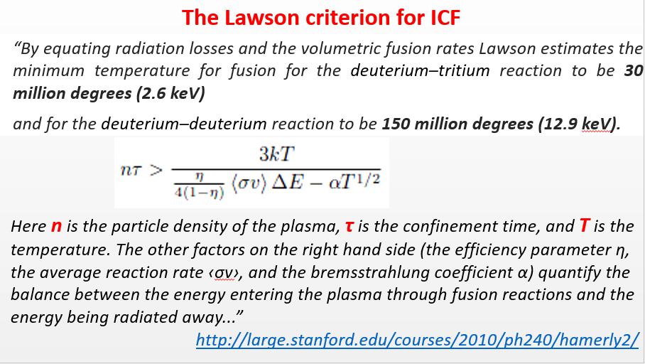

Slide 44
Thermal velocity

Slide 45
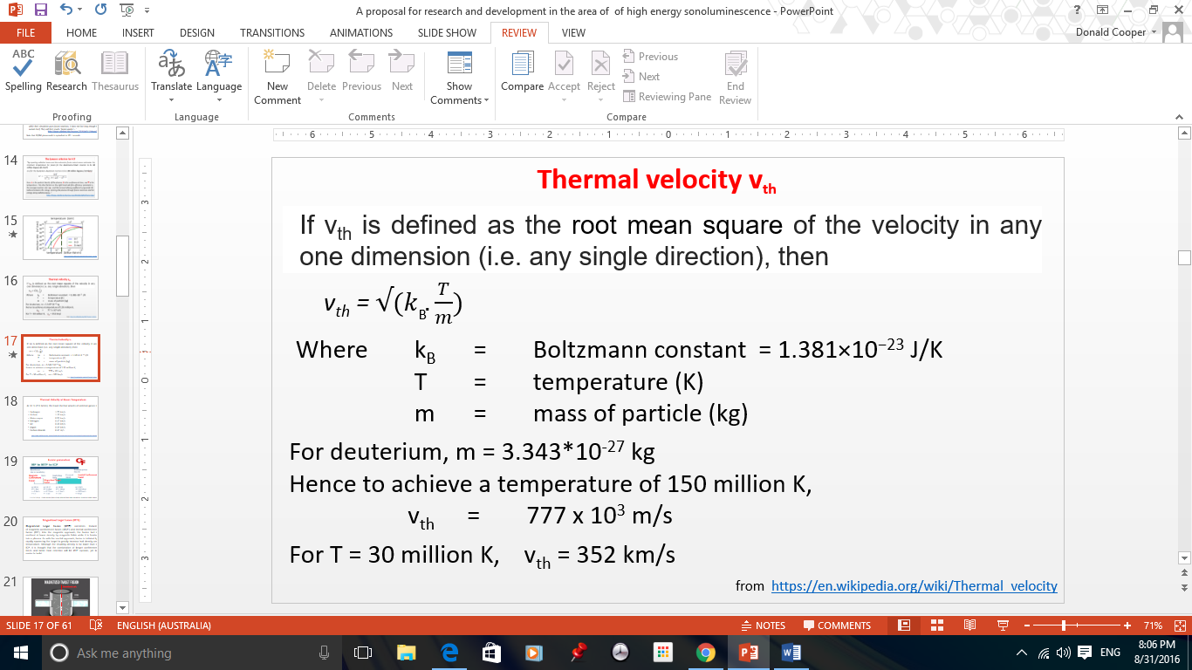
= 777 km/s

Slide 46
Instability

Slide 47
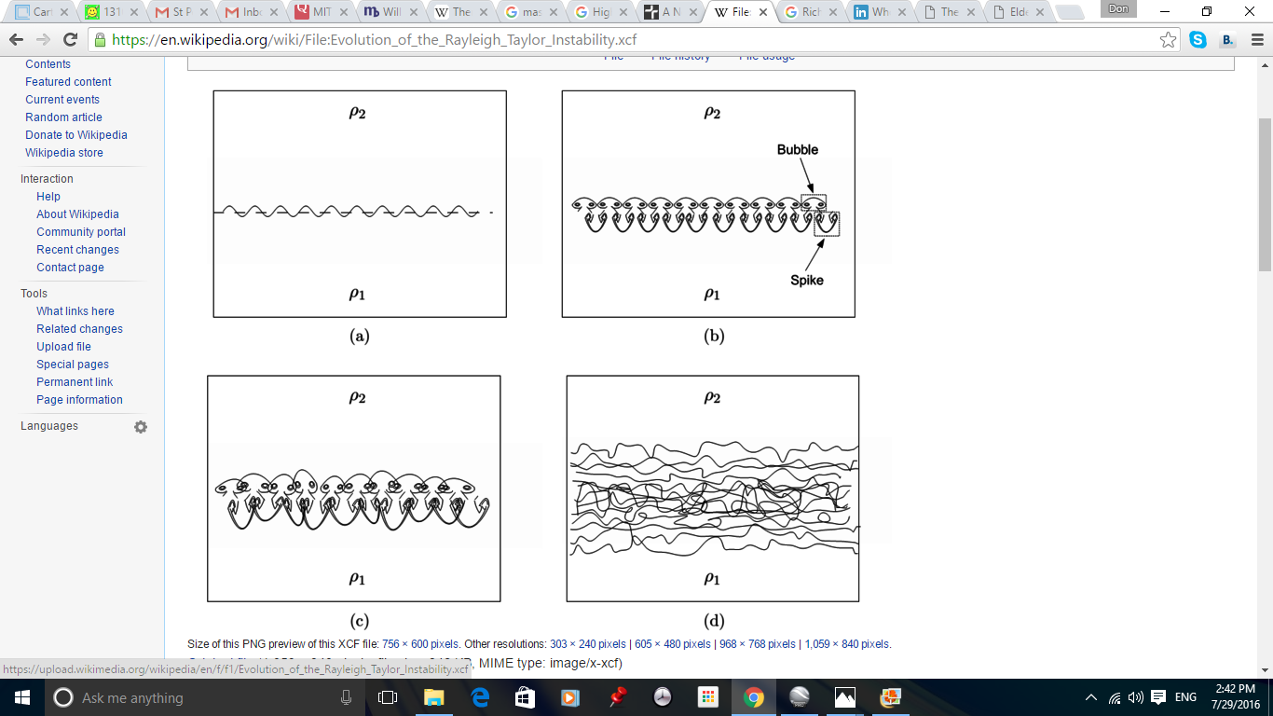
Rayleigh Taylor Instability
Shock wave direction
The equilibrium is unstable to any perturbations or disturbances of the interface: if a parcel of heavier fluid is displaced downward with an equal volume of lighter fluid displaced upwards, the potential energy of the configuration is lower than the initial state. Thus the disturbance will grow and lead to a further release of potential energy, as the more dense material moves down under the accelerational field, and the less dense material is further displaced upwards.
Wikipedia
Accelerational field
High density
Low density

Slide 48
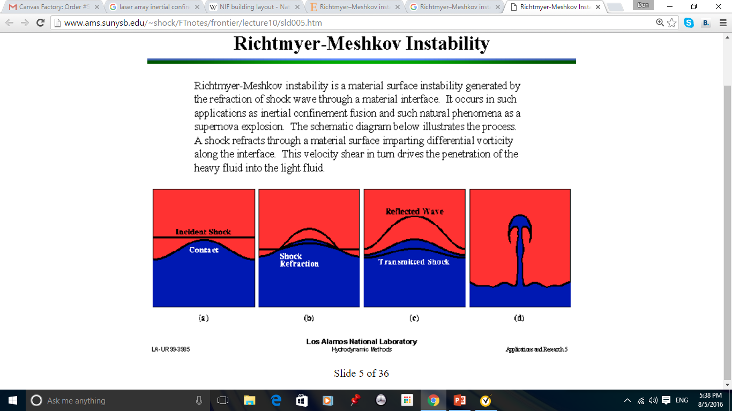
Richtmyer-Meshkov Instability
Light
Heavy

Slide 49
Medium velocity compression

Slide 50
General Fusion

Slide 51
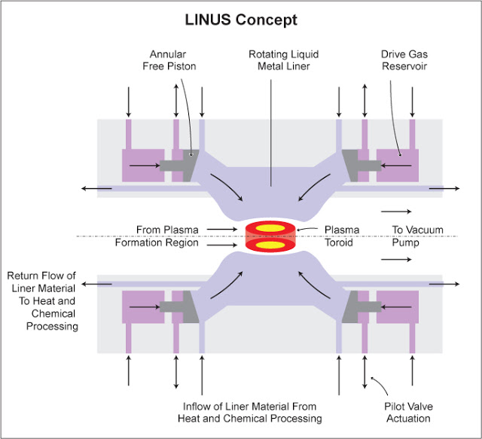
Rotational axis

Slide 52
General Fusion
“…In this example scenario that gave near optimal fusion yield, a 2 GPa acoustic pulse is applied to the outer radius of the Pb at 1.5 m and takes 700 μs to propagate towards the plasma. At the plasma-liner interface, the pulse reaches 12 GPa and compresses the plasma in 130 μs. The plasma is 50-50 deuterium-tritium with an effective ion charge of 1.5. The plasma model includes the effects of adiabatic compression, Bremsstrahlung, Bohm thermal transport, fusion reaction chains, and fast alpha confinement. The time axis becomes more sparse around t = 0 to better show the behavior during peak compression. The plasma is compressed radially by a factor of 18, increasing the magnetic field from 5 to 1600T, the ion density from 10^²² to 6x10^²⁵ m⁻³ , and the temperature from 0.1 to 15 keV. Peak fusion power is 3.6 TW and peak beta is 32%. The initial conditions for this compression scenario of T_{i} = 100 eV, n_{i} = 10²² m-3 , τ_{E} > 130 μs are within the range of achieved compact toroid (CT) conditions, the one technically challenging parameter is B₀ = 5 T, which is just beyond previous results yet not unreachable…”
http://www.generalfusion.com/blog/wp-content/uploads/2016/08/Laberge-2013-Acoustically-Driven-Magnetized-Target-Fusion.pdf

Slide 53
THIS COMPANY COULD POWER THE WORLD FOR 65 BILLION YEARS
CNN Money features General Fusion as a future energy solution. This segment is part of a CNN Money original series Elon. Evolution which explores the challenges facing humanity today as seen by Elon Musk.
http://www.generalfusion.com/blog/category/in-the-news/this-company-could-power-the-world-for-65-billion-years/

Slide 54
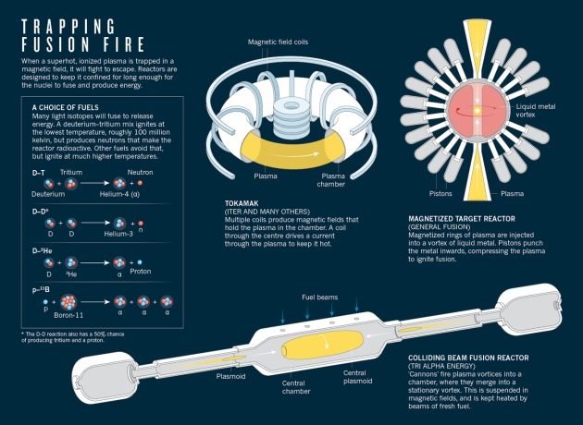
A Trap to Catch the Sun

Slide 55
Shock waves in Convergent Pipes

Slide 56
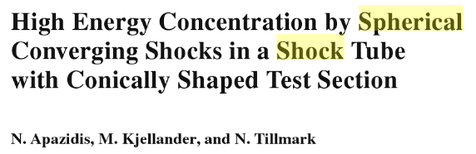
Department of Mechanics
Royal Institute of Technology, Sweden
29th International Symposium on Shock Waves (ISSW29) July 14 to July 19, 2013

Slide 57
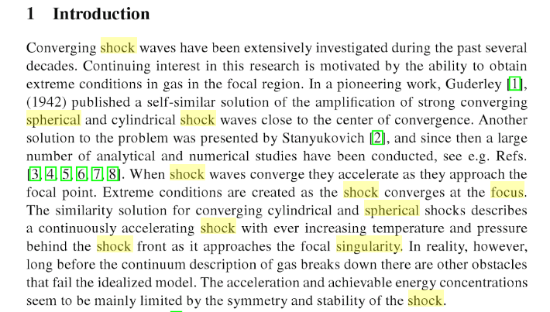
Shock waves in Convergent Pipes

Slide 58
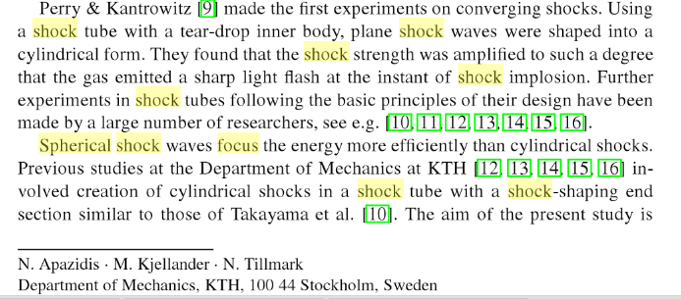
Shock waves in Convergent Pipes

Slide 59
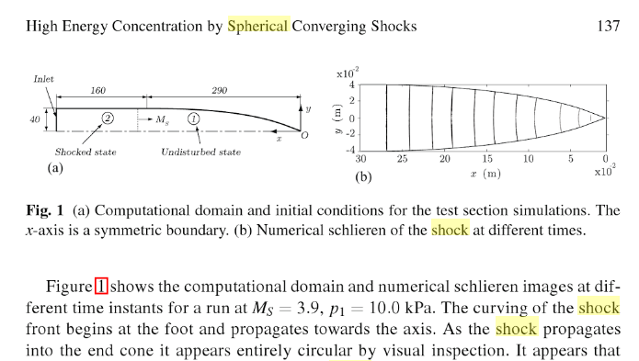
Shock waves in Convergent Pipes
Curving shock front

Slide 60
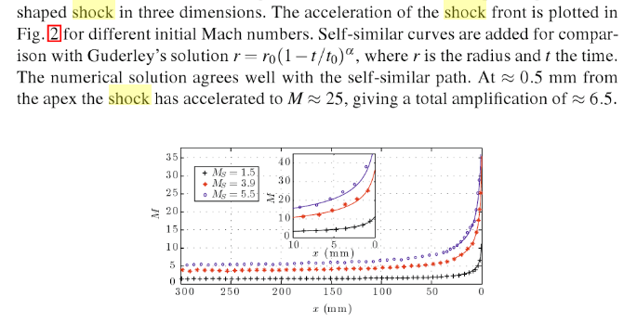
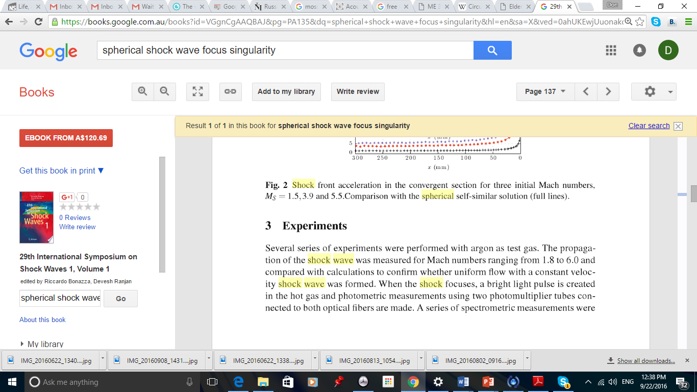
Shock waves in Convergent Pipes
…
Detail

Slide 61
Shock waves in Convergent Pipes
Maximum temperature recorded in this method was 40,000K. Heat transfer to the metal surface and instabilities within the implosion probably prevented measurement beyond this.
In this context, it should be noted that this temperature is around twice that achievable in an electric arc furnace and four times that in a furnace using chemical combustion.

Slide 62
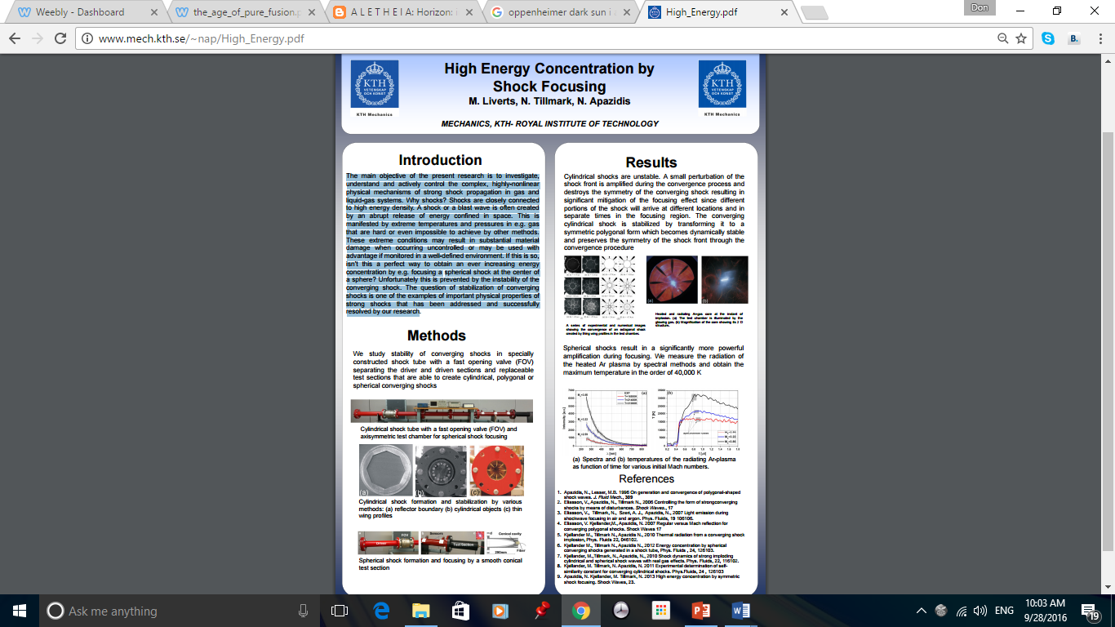

Slide 64
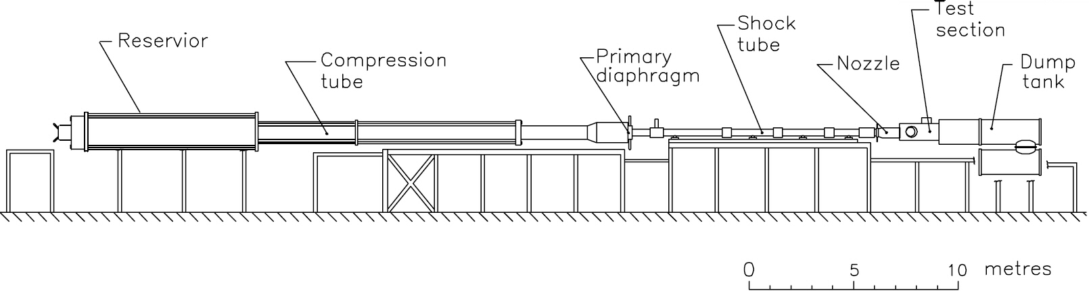
University of Queensland Shock Tube
Specifications
Compression tube: 229 mm ID x 26 m long
Piston mass: 92 kg
Shock tube: 76 mm ID x 10 m long
Contoured Nozzles:
  Mach 4
  Mach 6
  Mach 7
  Mach 8
  Mach 10
Nozzle supply enthalpy range: 2.5 - 15 MJ/kg
Nozzle supply pressure range: 10 - 90 MPa

Slide 65
Energy output of Tritium-Deuterium Reaction
The energy liberated by the fusion of 1 Kg of Deuterium with 1.5 Kg of Tritium is therefore 2.82 X 10⁻¹² X 2.99 X 10²⁶ = 8.43 X 10¹⁴ Joules = (8.43 X 10¹⁴) / (3.6 X 10¹²) GWHours = 234 GWHours.
http://www.mpoweruk.com/nuclear_theory.htm
The cost of a litre of heavy water is currently about $600. Electrolysis of this would yield about 200 gm of deuterium.

Slide 66
Sonofusion

Slide 68
http://homepages.rpi.edu/~laheyr/Sonofusion%20Paper-pdf_Lahey_NURETH-11.pdf

Slide 69
H.G.Wells
The World Set Free

Slide 70
…"It has begun," he writes in the diary in which these things are recorded. "It is not for me to reach out to consequences I cannot foresee. I am a part, not a whole; I am a little instrument in the armoury of Change. If I were to burn all these papers, before a score of years had passed some other man would be doing this."
The World Set Free H.G.Wells

Slide 71
“…The catastrophe of the atomic bombs which shook men out of cities and businesses and economic relations, shook them also out of their old established habits of thought, and out of the lightly held beliefs and prejudices that came down to them from the past.”
“The moral shock of the atomic bombs had been a profound one, and for a while the cunning side of the human animal was overpowered. Men thought twice before they sought mean advantages in the face of the unusual eagerness to realize new aspirations, and when at last the weeds revived again and "claims" began to sprout, they sprouted upon the stony soil of law-courts reformed, of laws that pointed to the future instead of the past, and under the blazing sunshine of a transforming world.”
“A new literature, a new interpretation of history, is springing into existence; a new teaching is already in the schools, a new faith in the hearts of the young. I see the crystal cup of human knowledge perpetually brimming. I see the fires of human thought rise from ten thousand altars of research, and flare out into the wilderness of space. I see the time when men will no longer be content with this little conquered planet…”
The World Set Free H.G. Wells.

Slide 72
Nietzsche

Slide 73
“...Man is a rope, tied between beast and overman - a rope over an abyss. A dangerous across, a dangerous on-the-way, a dangerous looking back, a dangerous shuddering and stopping.”
“What is great in Man is that he is a bridge and not an end: what can be loved in Man is that he is an overture…”
Thus Spake Zarathustra Nietzsche

Slide 74
…The ocean lies all around you; true, it is not always roaring, and sometimes it lies there as if it were silken and golden and a gentle favourable dream. But there will be times when you will know that it is infinite and that there is nothing more terrible than infinity...
Alas, if homesickness for land should assail you, as if there were more freedom there - and there is no longer any 'land'!..
Die fröhliche Wissenschaft Nietzsche

Slide 76
…"We knew the world would not be the same. A few people laughed, a few people cried. Most people were silent.”
“I remembered the line from the Hindu scripture, the Bhagavad-Gita. Vishnu is trying to persuade the Prince that he should do his duty, and, to impress him, takes on his multi-armed form and says, 'Now I am become Death, the destroyer of worlds.' “
“I suppose we all thought that, one way or another“…
Oppenheimer interviewed about the Trinity explosion, first broadcast as part of the television documentary The Decision to Drop the Bomb (1965)

Slide 77
…I’m not afraid, because I will ever believe in the constructive and intelligent behaviour of men – in spite of everything. Because I know the other side of the story: these pure fusion detonators that threaten us, will on the other hand give us a huge constructive engineering power that there must be no [scarcity anymore]. Endless energy, endless basic materials, endless forces to move huge loads, even smaller celestial bodies. We don’t have to be afraid. Paradise on earth, as it was the dream of our ancestors, is very near, if we let it happen. A free paradise based on human intelligence, based on endless energy and endless reserves of raw materials – literally endless space to discover and settle. There is enough room for all of us…
https://monstermaschine.wordpress.com/2012/09/25/why-mankind-must-not-fear-the-pure-fusion-bomb/

